Slide 1


TEXT DETECTION AND ANALYSIS USING TKINTER AND VADER SENTIMENT ANALYSIS
SUBMITTED BY SUPERVISED BY
Hamza Dr.Ihtiram Raza Khan
2020 – 350 – 020 Associate Professor
B. Tech CSE-AI Computer Science & Engineering
SUBMITTED TO
Department of Computer Science & Engineering
School of Engineering Sciences & Technology
JAMIA HAMDARD
Mirjam Nilsson​​

Slide 2
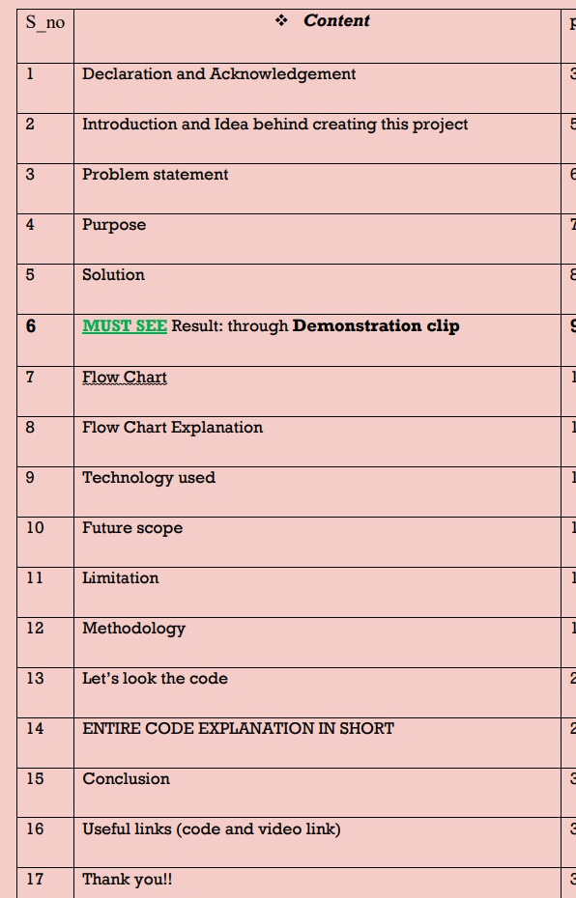

AGENDA
Introduction
Primary goals
Areas of growth
Timeline
Summary

Slide 3
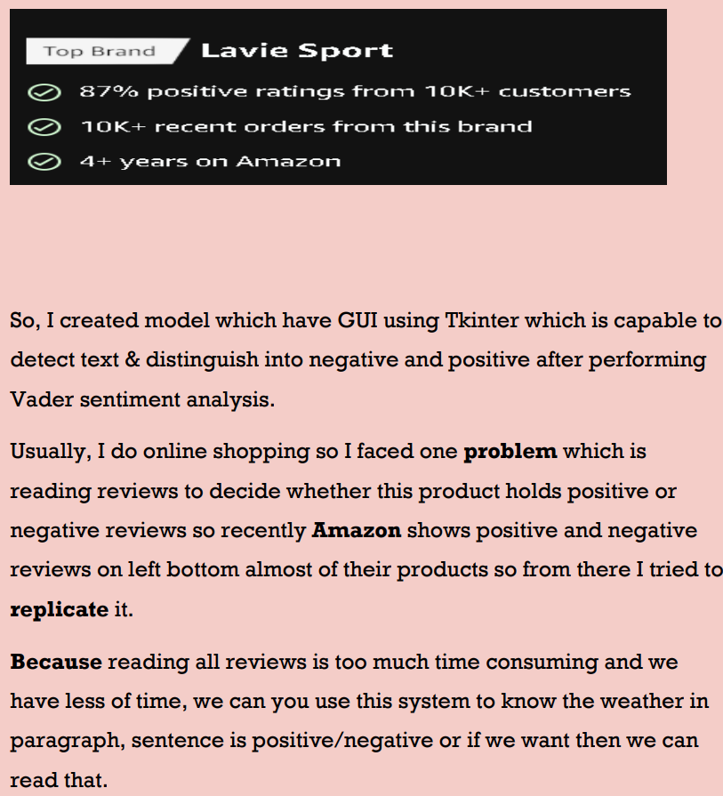

INTRODUCTION

Slide 4

Problem statement
Build system that can understand the sentiment behind the text (like human does), and show the positive and negative

Slide 5
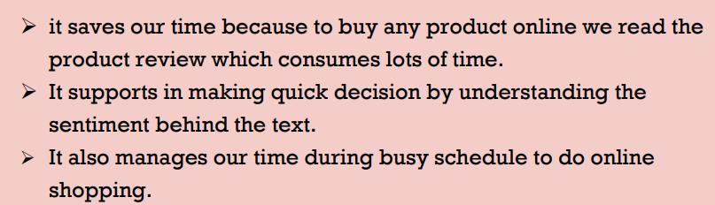
Purpose

Slide 6
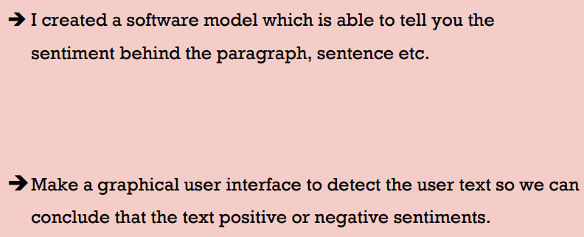
Solution

Slide 7
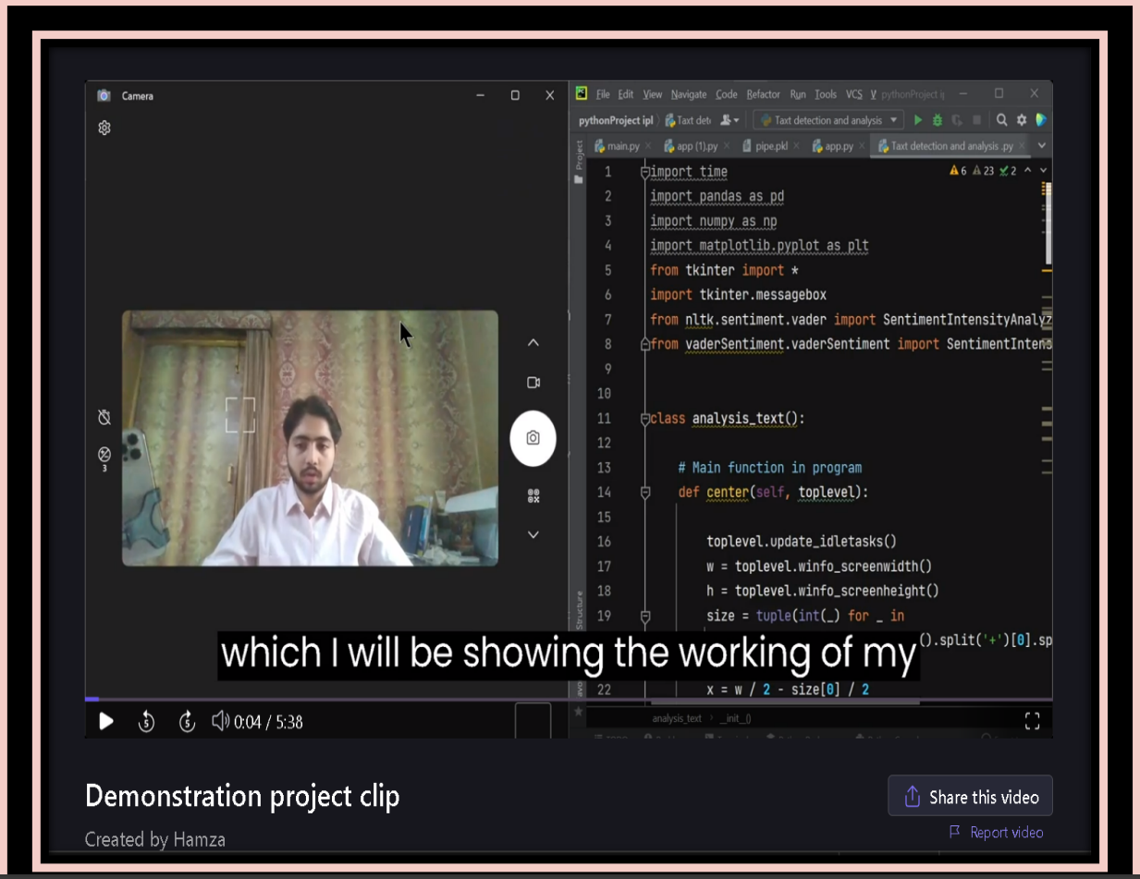
CLICK HERE OR ON IMAGE TO SEE WORKING AND RESULT OF MY PROJECT
Result: DEMONSTRATION CLIP

Slide 8
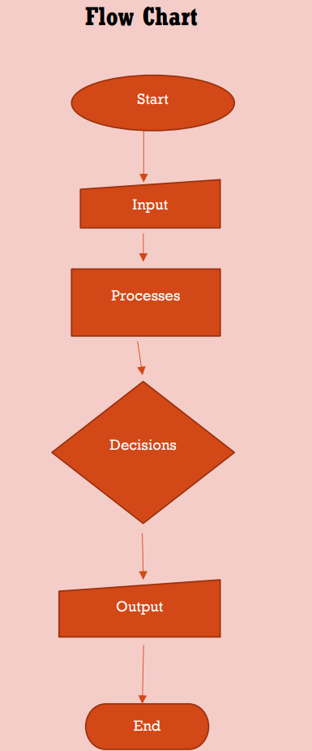
Flow Chart

Slide 9
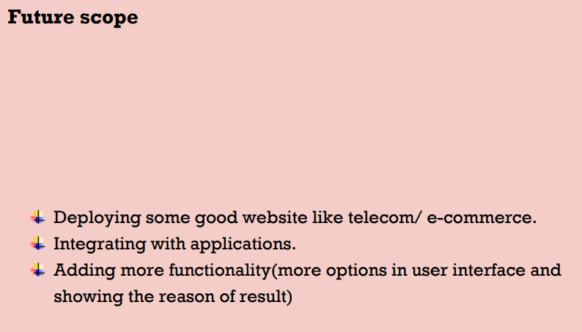








MEET OUR TEAM
Takuma Hayashi
Mirjam Nilsson
Flora Berggren
Rajesh Santoshi
President
Chief Executive Officer
Chief Operations Officer
VP Marketing
Graham Barnes
Rowan Murphy
Elizabeth Moore
Robin Kline
VP Product
SEO Strategist
Product Designer
Content Developer

Slide 10
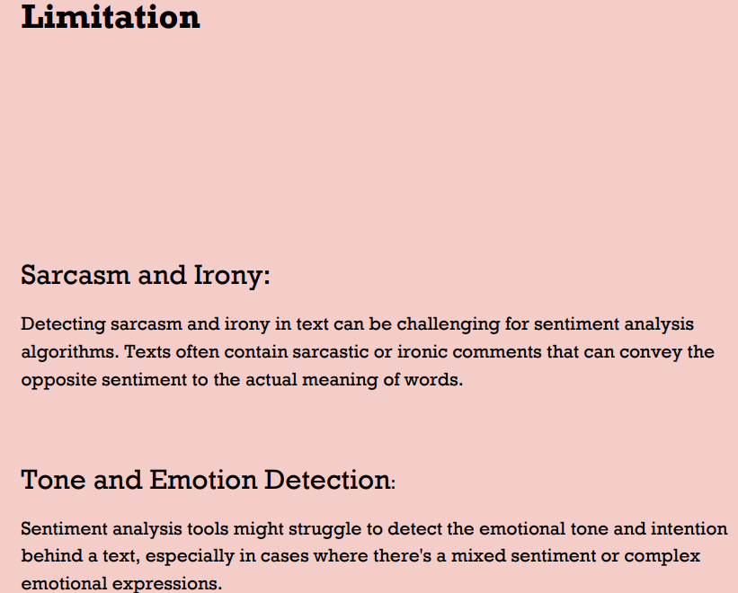
PLAN FOR PRODUCT LAUNCH
Planning
Synergize scalable e-commerce
Marketing
Disseminate standardized metrics
Design
Coordinate e-business applications
Strategy
Foster holistically superior methodologies
Launch
Deploy strategic networks with compelling e-business needs

Slide 11
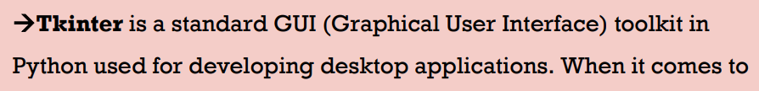
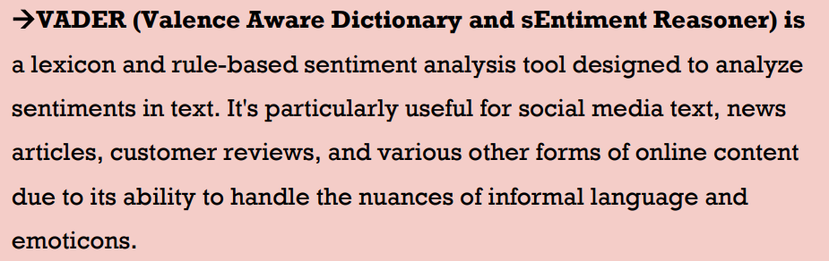
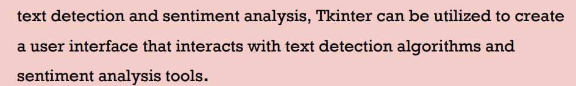
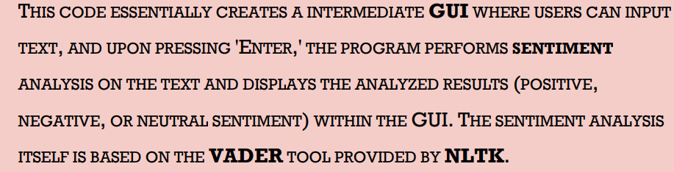
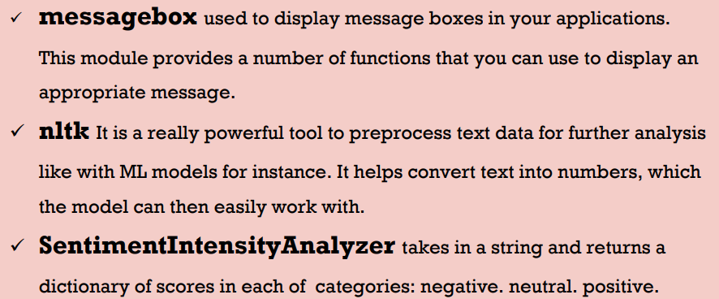
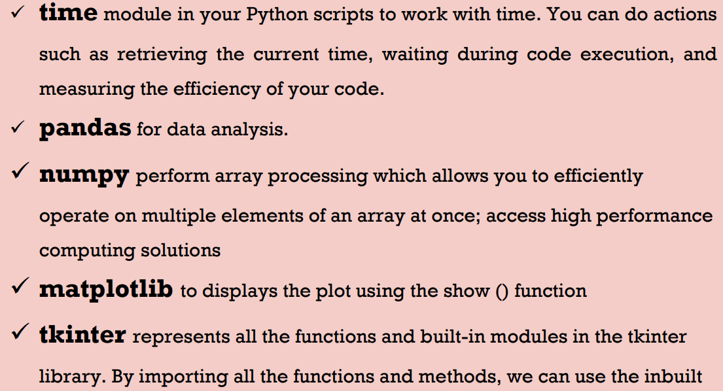
Project learnings
Sept 20XX
Synergize scalable e-commerce
Nov 20XX
Disseminate standardized metrics
March 20XX
Deploy strategic networks with compelling e-business needs
May 20XX

Slide 12


Conclusion
The project on Text Detection and Analysis utilizing Tkinter and VADER sentiment analysis offers a comprehensive exploration into text-based sentiment analysis through a user-friendly graphical interface. The integration of Tkinter, a powerful GUI toolkit, and VADER sentiment analysis, a lexicon and rule-based sentiment analysis tool, provides a functional platform for users to input text, analyze sentiments, and receive immediate feedback regarding the sentiment of their text inputs.
In conclusion, this project serves as a foundational demonstration of the amalgamation of a user interface created with Tkinter and the capabilities of VADER sentiment analysis. It provides a solid framework for further enhancements and the potential for integration into various applications, including social media analysis, customer feedback processing, and broader natural language processing tasks. Continuing advancements in sentiment analysis methodologies and user interface design will further refine and expand the capabilities demonstrated in this project.

Slide 13

THANK YOU!!
HAMZA 020
hamzashamim2001@gmail.com
7703993678

